Slide 1
Cape Lab
Group : 1
Name : Satyam Rahangdale
Roll no. : 22CH10062
Week – 2 (24/01/25)
Topic – System of Non-linear Equation

Slide 2
Summary
Problem 1 : CSTR
Solutions :
Fixed-point iteration
MATLAB built in function fsolve
Problem 2 : Flow in Pipe
Solutions :
Fixed-point iteration
MATLAB built in function fsolve
Conclusion

Slide 3
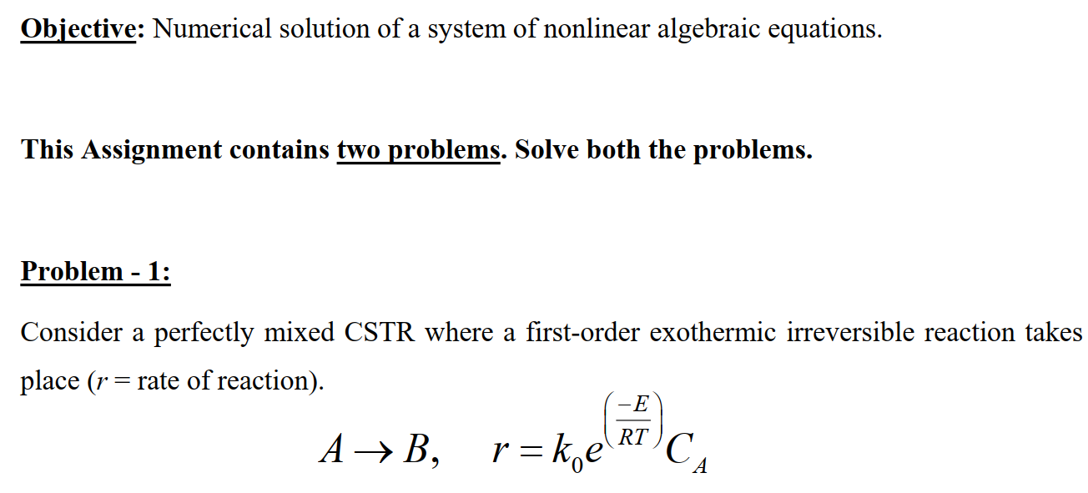
Problem 1

Slide 4
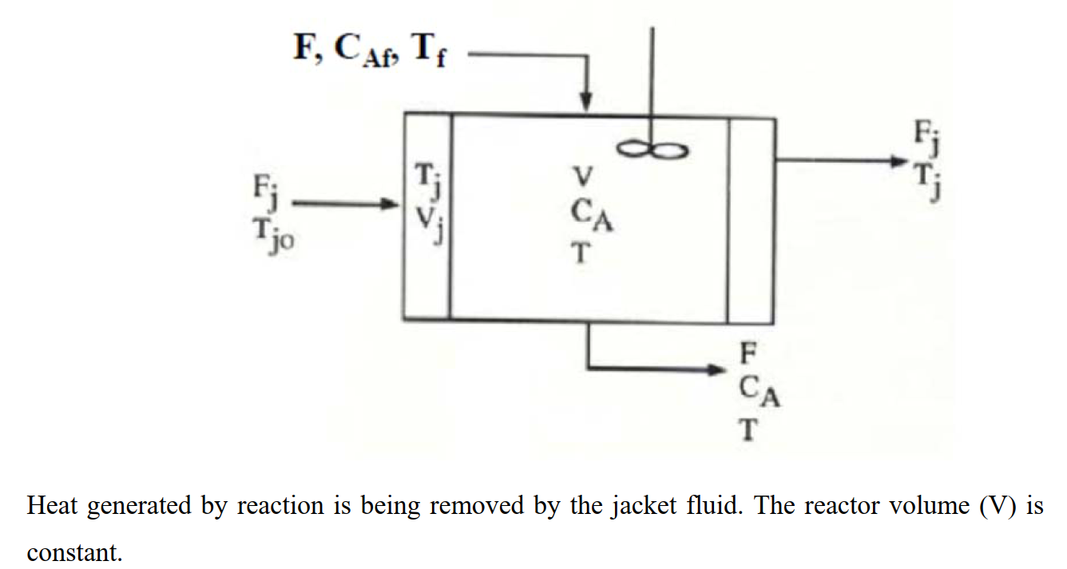

Slide 5
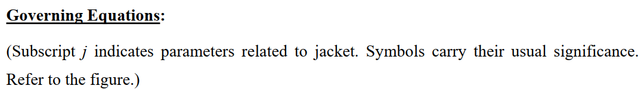
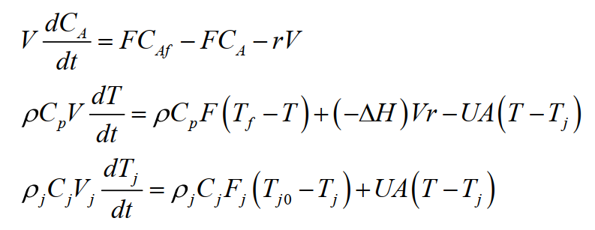

Slide 6
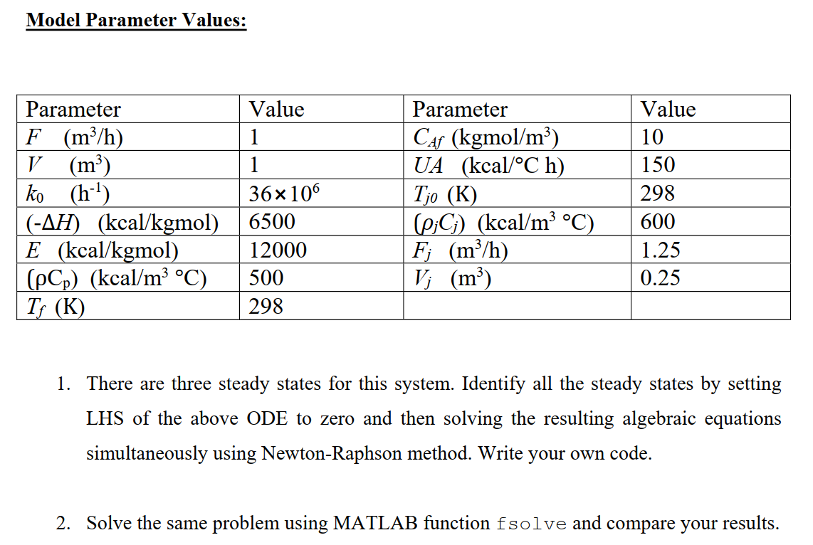

Slide 7
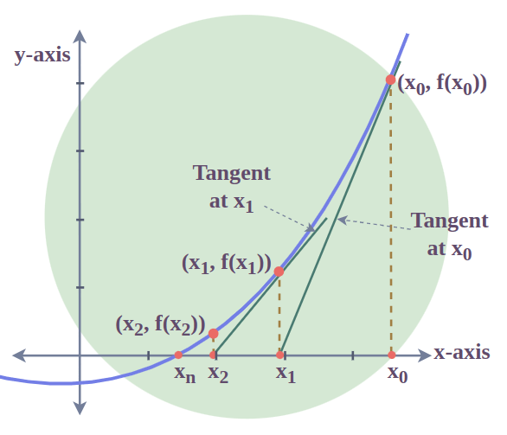
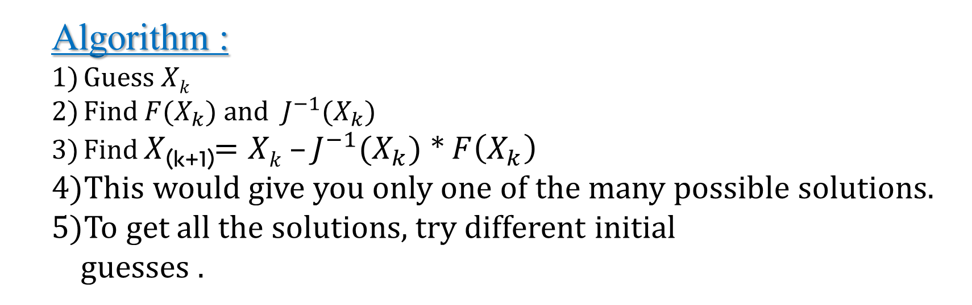
a) Newton’s Rapson Method(Multivariable)
Algorithm :
Guess $Xk$
Find $F(X_{k})$and $J^{−1}$($X_{k})$
Find $X$_{(k+1)}$=Xk –J^{−1}\text{(}X_{k})$ * $F\left(X_{k}\right)$
This would give you only one of the many possible solutions.
To get all the solutions, try different initial
guesses .
Order of convergence = 2.

Slide 8
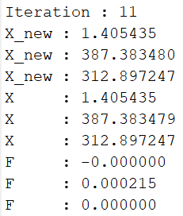
Results :-
Code

Slide 9
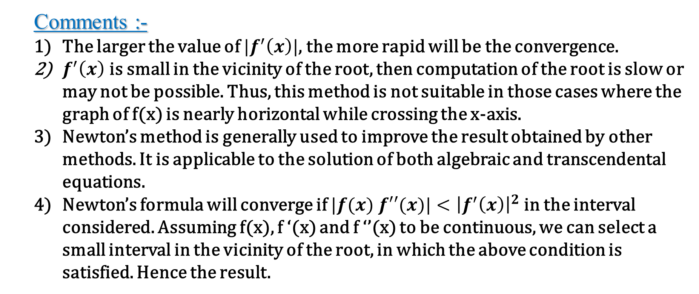
Analysis of Results :-
Comments :-
The larger the value of $|f^{′}\left(x\right)|$, the more rapid will be the convergence.
$f^{′}\left(x\right)$ is small in the vicinity of the root, then computation of the root is slow or may not be possible. Thus, this method is not suitable in those cases where the graph of f(x) is nearly horizontal while crossing the x-axis.
Newton’s method is generally used to improve the result obtained by other methods. It is applicable to the solution of both algebraic and transcendental equations.
Newton’s formula will converge if $|f(x) f′′(x)|<{\left|f^{′}\left(x\right)\right|}^{2}$in the interval considered. Assuming f(x), f ‘(x) and f ‘’(x) to be continuous, we can select a small interval in the vicinity of the root, in which the above condition is satisfied. Hence the result.

Slide 10
b) Built in fsolve
Algorithm :
Make initial guess of CA, T ,Tj as close as possible to solution.
Call built in fsolve function
For getting other possible solutions try different initial guesses.
Code[Matlab]

Slide 11
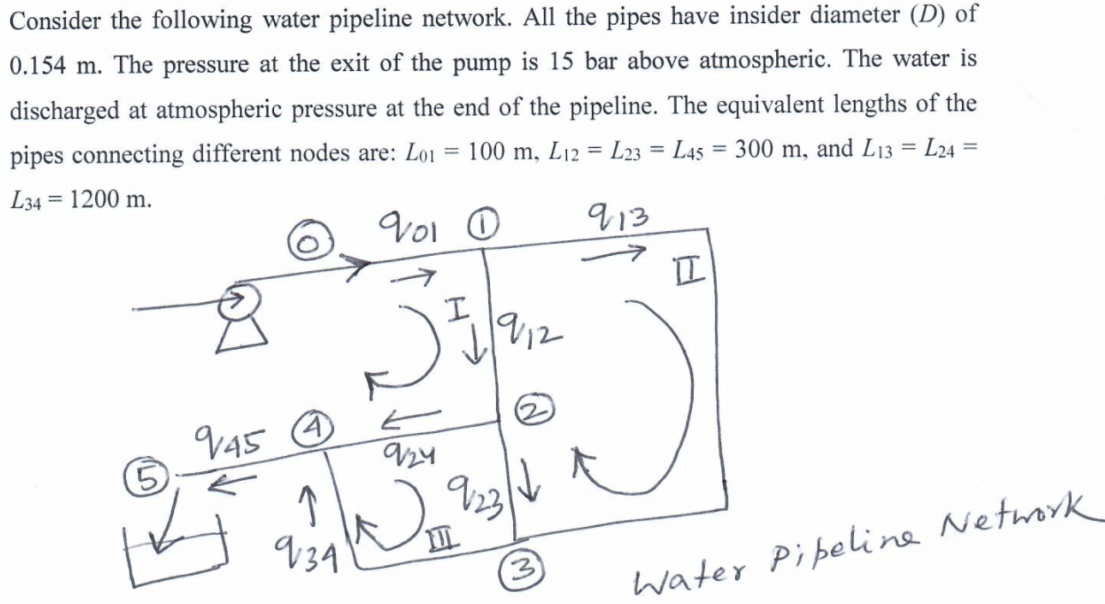
Problem 2

Slide 12
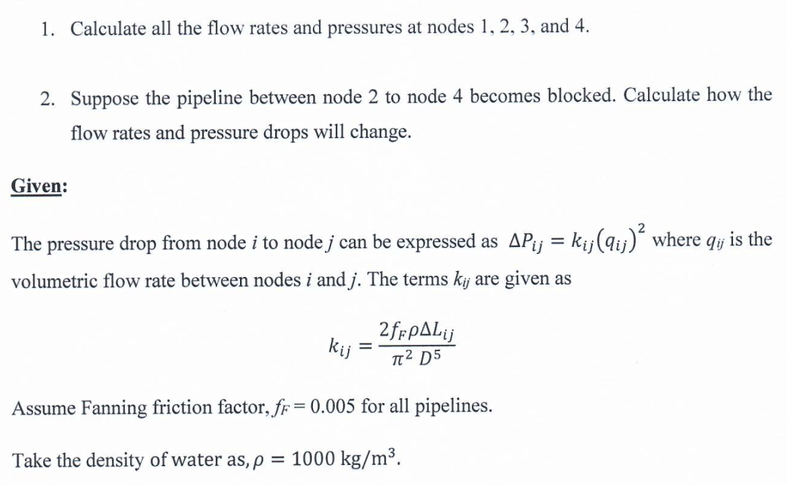

Slide 13






$$P_{0}=16 bar$$
$$P_{1}=16 bar$$
$$P_{atm}=1 bar$$
0
1
$$P_{01}= ?, q_{01}= ?$$
$$∆P_{pump}=15 bar$$
4
2
3

Slide 14
b) Built in fsolve
Algorithm :
We have 7 variables and 7 equation ( 4 equation are flow balance in and out of node, 1 equation is total flow in = total flow out and rest two are pressure drop balance in Loop 1 and 2 ).
Make initial guess of X= [initial_guess] = [q01; q12; q23; q13; q24; q34; q45];
Call built in fsolve function.
Code[Matlab]

Slide 15
$$P_{0}=16 bar$$
$$P_{1}=16 bar$$
$$P_{atm}=1 bar$$
0
1
$$P_{01}= ?, q_{01}= ?$$
$$∆P_{pump}=15 bar$$
4
2
3

